Slide 1
Bio& 241 A&P
Unit 1 / Lab 4

Slide 2
Histology Slides for the Epithelial, Connective, and Integumentary Tissues
Slides are presented in order of magnification
As you view the following slides, make sure you can accomplish these goals:
Can you identify the tissue observable on the slides?
Can you identify the specific structures or layers indicated by the numbered arrows or brackets?
At the end of a sequence, you will find the answers to the above for each vessel and layer.

Slide 3
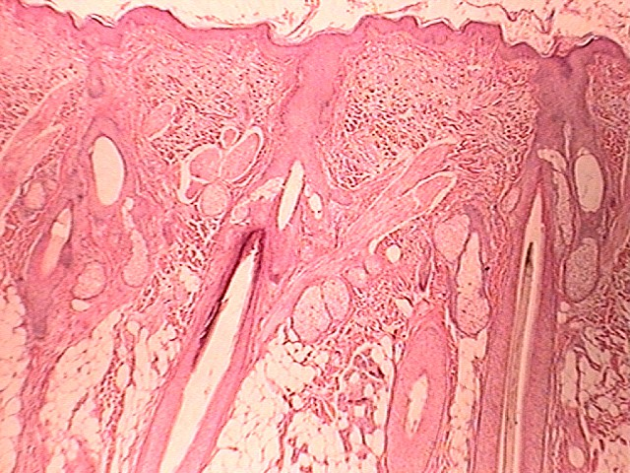
Identify layers, tissues
and structures
1
40X
2
5
6
3
6
7
4
8

Slide 4
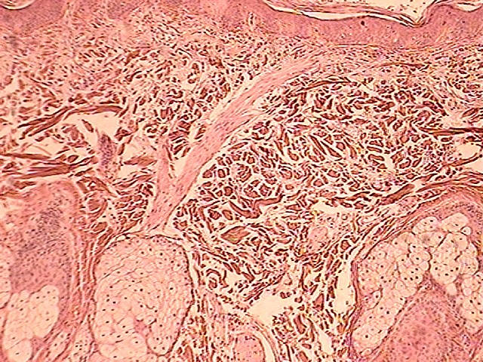
Identify layers, tissues
and structures
1
2
6
3
7
7
7
100X

Slide 5
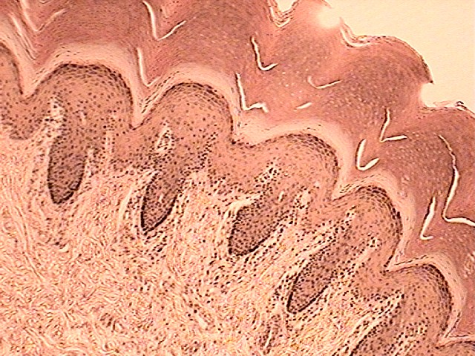
Identify layers, tissues
and structures
100X
9
10
12
11
2
13
3

Slide 6
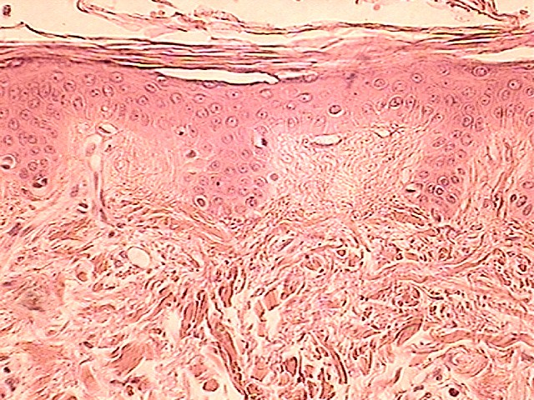
9
11
12
2
13
3
Identify layers, tissues
and structures
400X

Slide 7
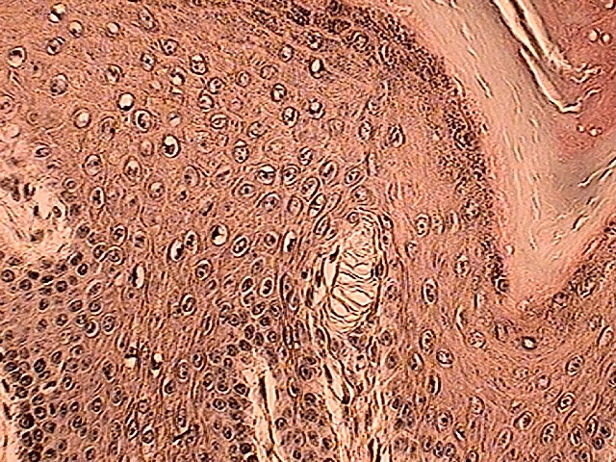
Identify layers, tissues
and structures
10
12
14
15
400X

Slide 8
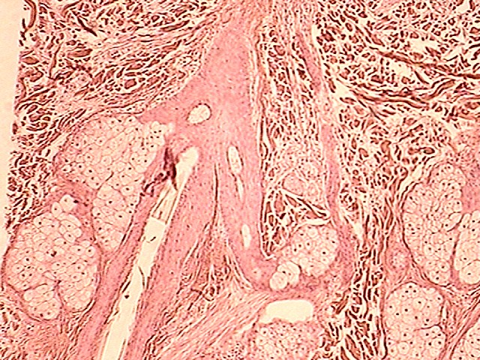
Identify layers, tissues
and structures
400X
3
7
7
7
5

Slide 9
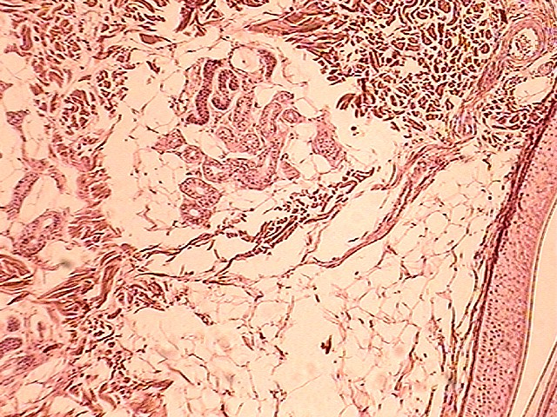
Identify layers, tissues
and structures
3
8
5
4
400X

Slide 10
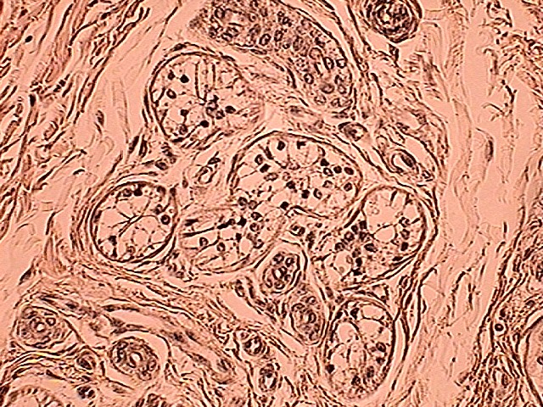
Identify layers, tissues
and structures
8
400X

Slide 11
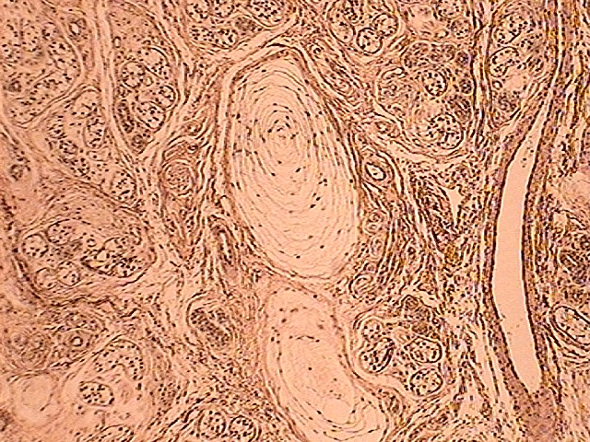
Identify layers, tissues
and structures
8
8
16
8
400X

Slide 12
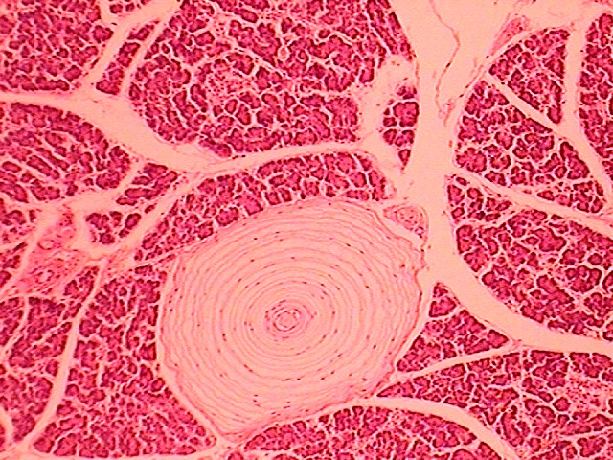
Identify layers, tissues
and structures
16
400X

Slide 13
Answers to Integumentary Slides
Slide 3: Human scalp overview
Slide 4: Human scalp low power
Slide 5: Primate finger tip low power epidermis/dermis interface
Slide 6: Human scalp high power epidermis/dermis interface
Slide 7: Primate fingertip high power of epidermis
Slide 8: Human scalp high power of dermis
Slide 9: Human scalp high power dermis/hypodermis interface
Slide 10: Primate finger tip high power of the dermis
Slide 11: Primate finger tip high power of the dermis
Slide 12: Pancreas high power

Slide 14
Answers to Integumentary Slides
Guide to numbers:
Layer: Epidermis
Tissue: Keratinized Stratified Squamous
Layer: Papillary region of the dermis
Tissue: Areolar tissue
Layer: Reticular region of the dermis
Tissue: Dense Irregular Connective Tissue
Layer: Hypodermis
Tissue: Adipose tissue
Hair shaft
Arrector Pili muscle
Sebaceous gland
Sudoriferous (ecrine) gland

Slide 15
Answers to Integumentary Slides
Guide to numbers:
Stratum Corneum
Stratum Lucidum
Stratum Granulosum
Stratum Spinosum
Stratum Basale or Germinativum
Meissner’s Corpuscle
Dermal Papilla
Pacinian Corpuscle

